Slide 1
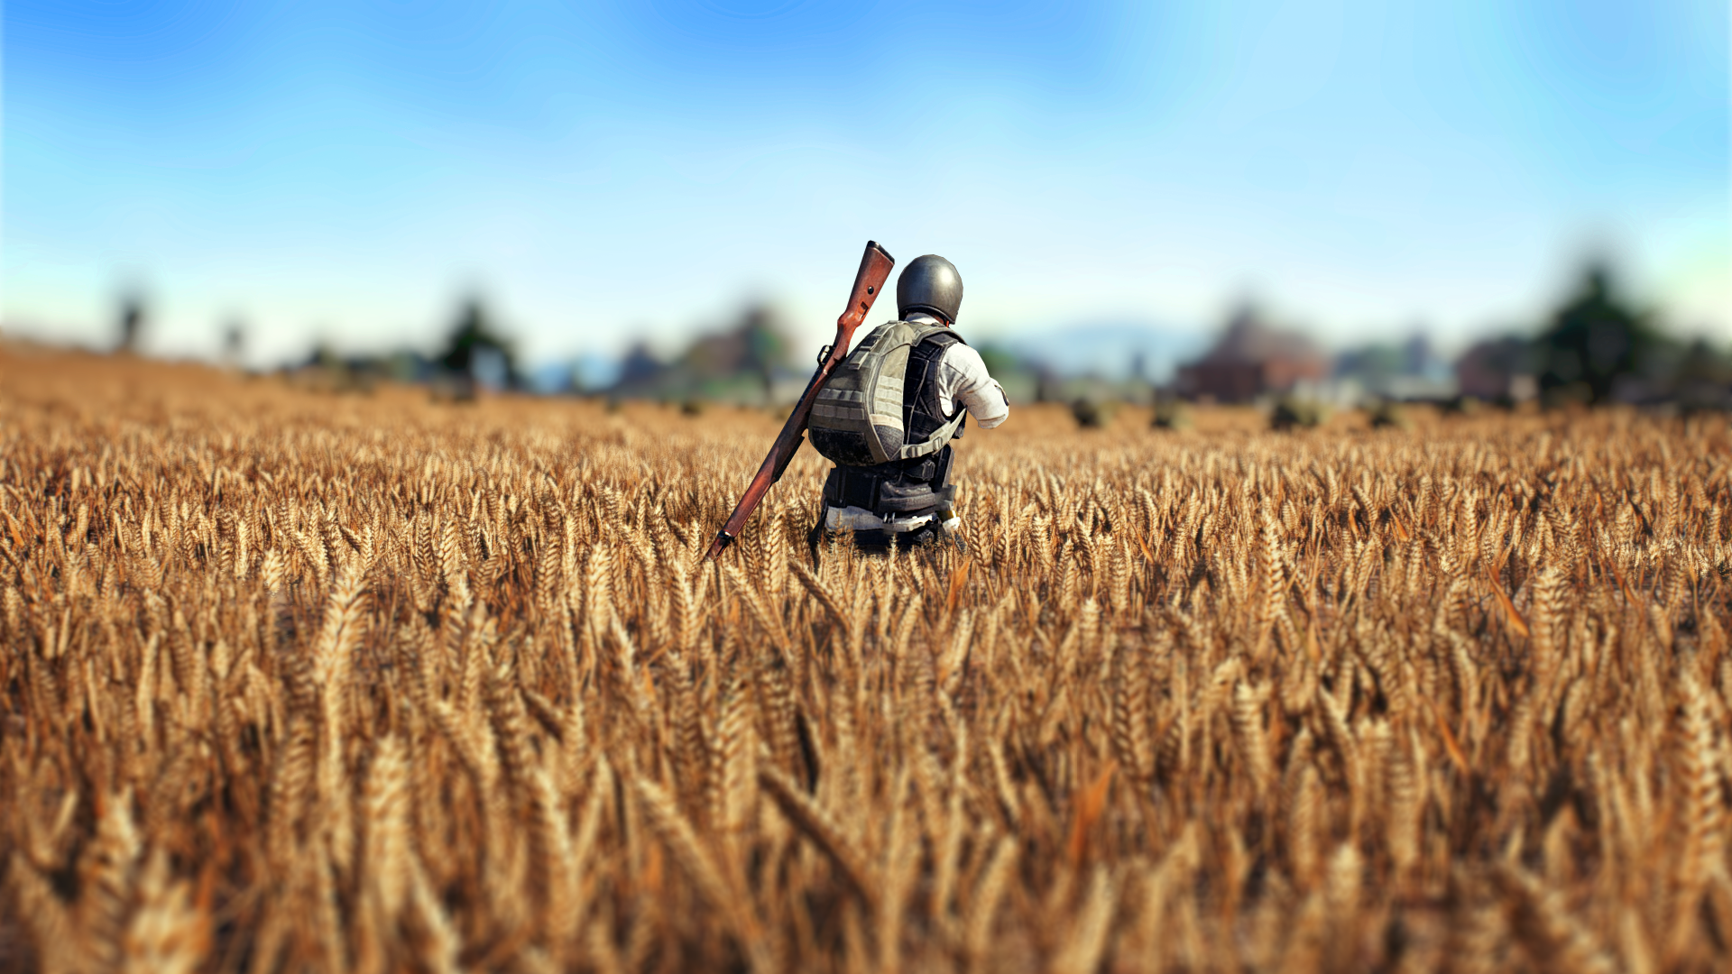
PUBG
PREDICTING THE CHANCES OF WINNING
GROUP - 9
Manimegala Muthu | Omkar Mutreja | Chris Negiz | Weicheng Wu | Renjie Luo

Slide 2

INTRODUCTION
PUBG abbreviated as Player Unknown’s Battle Grounds
The Game : Players are dropped into a wide, open area, and they must fight to survive while the battlefield shrinks which adds more pressure. Killing the competition, increases player survival and a chance to loot the gear from a dead player.
Game Channels : Smart Phone App & Computer
Fun Facts : 5th Best selling game of all time with over millions of active monthly users

Slide 3

OBJECTIVES
To explain the dataset and sampling
To understand the relationship between the numerical and categorical variable
Performing exploratory data analysis on the different variables
Report the key findings in terms of descriptive statistics

Slide 4
Dataset Description
Data source : Kaggle : https://www.kaggle.com/c/pubg-finish-placement-prediction/data
Variable Name | Description | Data Type | Unit
Id | Player's Id | Numerical Discrete | NA
assists | Number of enemy players this player damaged that were killed by teammates | Numerical Discrete | No. of units
boosts | Number of Boost items used | Numerical Discrete | No. of units
damageDealt | Total damage dealt. Note – Self inflicted damage is subtracted | Numerical Continous | No. of units
DBNOs | Number of enemy players knocked | Numerical Discrete | No. of units
headshotKills | Number of enemy players killed with headshots | Numerical Discrete | No. of units
heals | Number of heal items used | Numerical Discrete | No. of units
kills | Number of enemy players killed | Numerical Discrete | No. of units
killStreaks | Max number of enemy players killed in a short amount of time | Numerical Discrete | No. of units
matchType | Game mode – Solo/ Duo/ Squad | Categorical Nominal | NA
revives | Number of times this player revived teammates | Numerical Discrete | No. of units
rideDistance | Total Distance travelled in vehicles measured in meters | Numerical Continuous | meters
roadKills | Number of kills while in a vehicle | Numerical Discrete | No. of units
swimDistance | Total distance travelled by swimming measured in meters | Numerical Continuous | meters
teamKills | Number of times this player killed a teammate | Numerical Discrete | No. of units
vehicleDestroys | Number of vehicles destroyed | Numerical Discrete | No. of units
walkDistance | Total distance travelled on foot measured in meters | Numerical Continuous | meters
weaponsAcquired | Number of weapons picked up | Numerical Discrete | No. of units
winPoints | Win-Based External ranking of the player | Numerical Discrete | No. of units
winPlacePerc | The target of prediction ranging between 0 and 1 | Numerical Continuous | NA

Slide 5

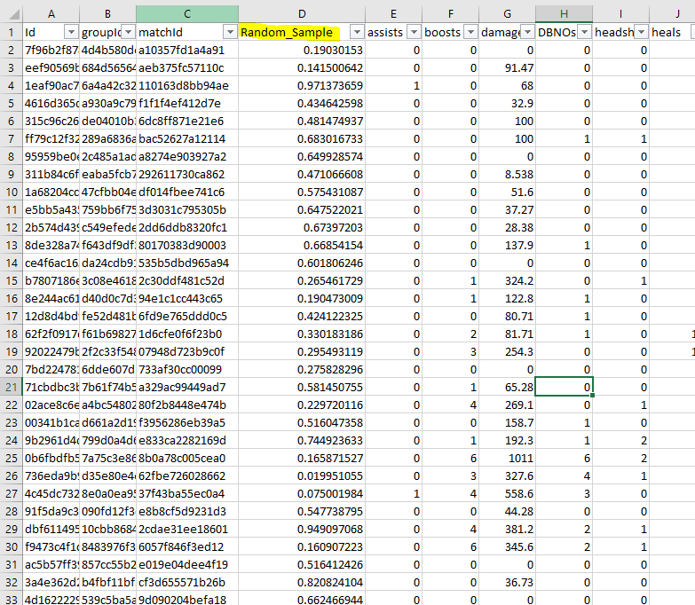
Data Description cont.
Population of Interest : Millennials (Age range – 15 to 35)
Original Dataset : 1.93 million observations
Sampled Dataset : 15000 observations
Since the original dataset was very large, we used the RAND() in excel and sampled the data
There are three types of matches and our sample data contains 5000 records of each type

Slide 6
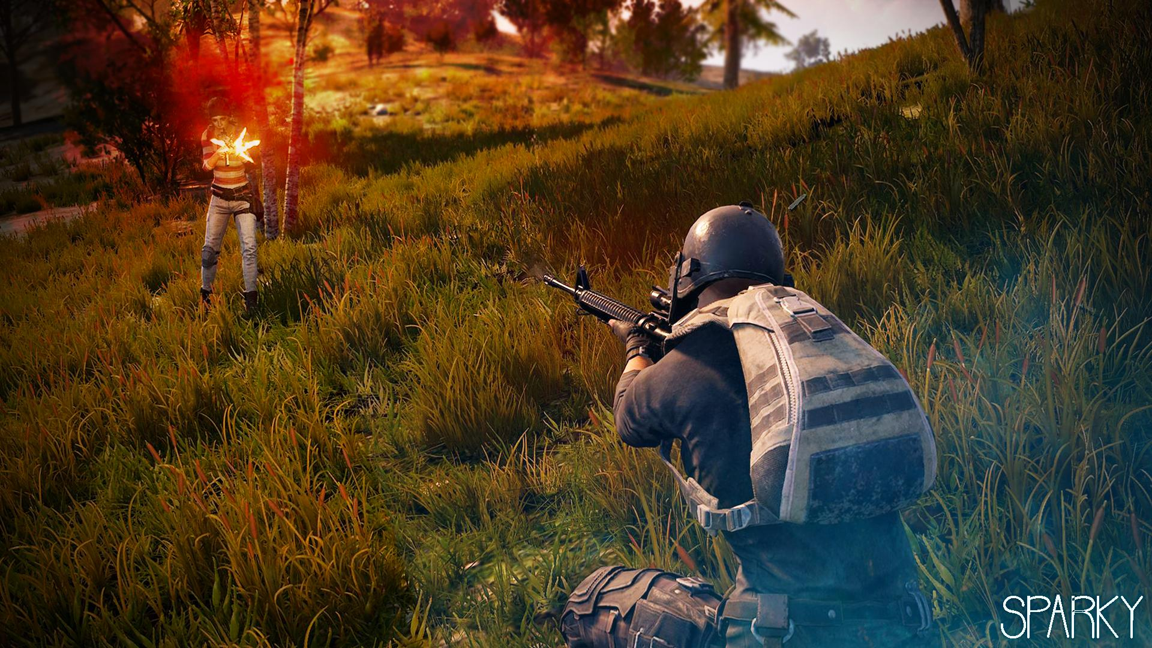
PART A
DESCRIPTIVE ANALYSIS

Slide 7
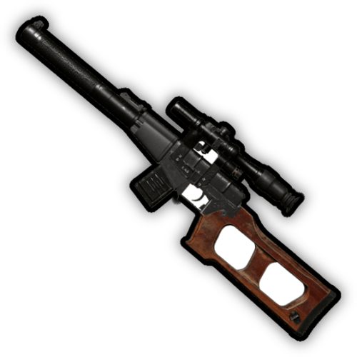
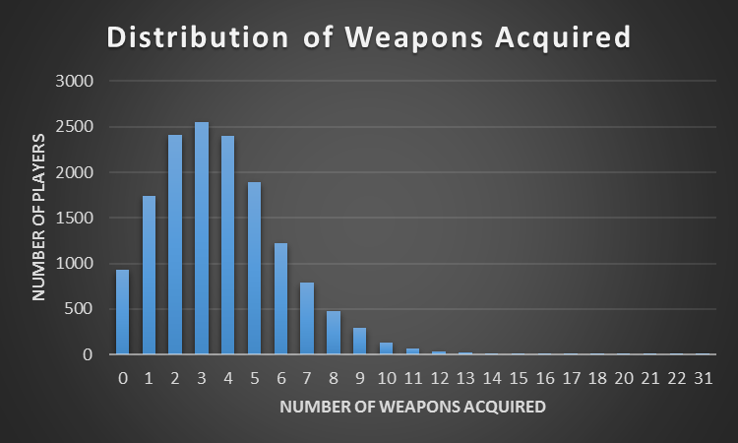
Weapon Statistics
On average a player acquires 3.7 weapons in a single game
83% of the players acquire more than 1 weapon
Only 6% of the players didn’t acquire any weapon
The maximum number of weapons acquired by a player* is 31
The Standard Deviation is 2.42

Slide 8

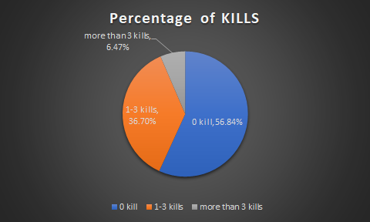
Kill Statistics
On average, a player kills 0.89 enemies in a single game
If a player kills 7 enemies in a match, the player has already exceeded 99% of other players
56.8% of the players didn’t kill any enemy
The maximum number of enemies killed by a player* is 18
The Standard Deviation is 1.53

Slide 9
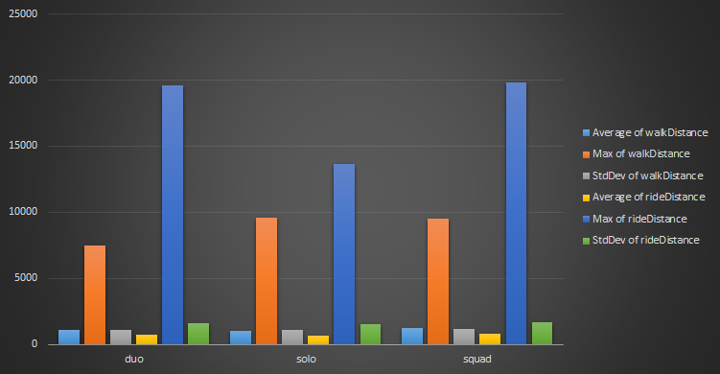
Walk & Ride Statistics – Pivot Table & Pivot Chart
On average a player walks 1250 meters and rides 768 meters in a squad battle which is the highest compared to Duo and Solo battles
4% of the players die even before they start moving on the ground i.e., they were shot dead immediately after they jumped
9551 meters is the maximum distance walked by a player*
Row Labels | Average of walkDistance | Max of walkDistance | StdDev of walkDistance | Average of rideDistance | Max of rideDistance | StdDev of rideDistance
duo | 1104.340954 | 7474 | 1089.777542 | 729.7968073 | 19600 | 1632.853816
solo | 1002.745454 | 9551 | 1058.311619 | 636.9459998 | 13650 | 1538.66055
squad | 1250.385439 | 9488 | 1182.60712 | 767.6186467 | 19850 | 1694.780622
Grand Total | 1119.157282 | 9551 | 1116.049299 | 711.4538179 | 19850 | 1624.187797

Slide 10
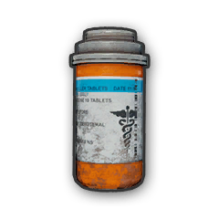
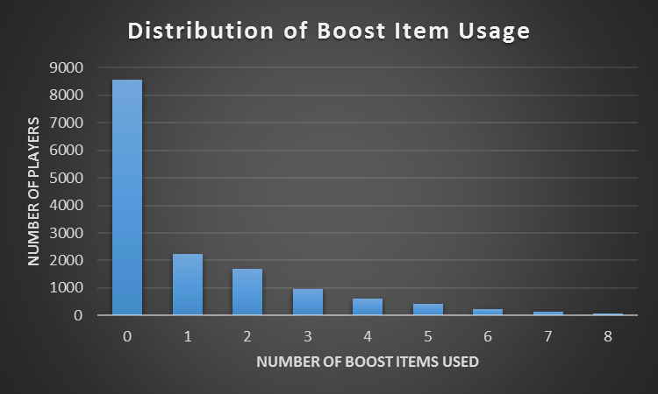
Boost Items Statistics
On average a player uses 1.1 Boost items in a single game
72% of the players use less than 1 Boost item
57% of the players didn’t use any Boost item
The maximum number of Boost items used by a player* is 14

Slide 11

Heal Items Statistics
On average a player uses 1.3 Heal items in a single game
76% of the players use less than 1 Heal item
62% of the players didn’t use any Heal item
The maximum number of Heal items used by a player* is 39

Slide 12
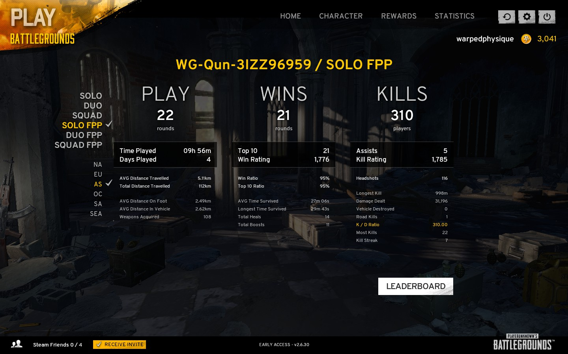
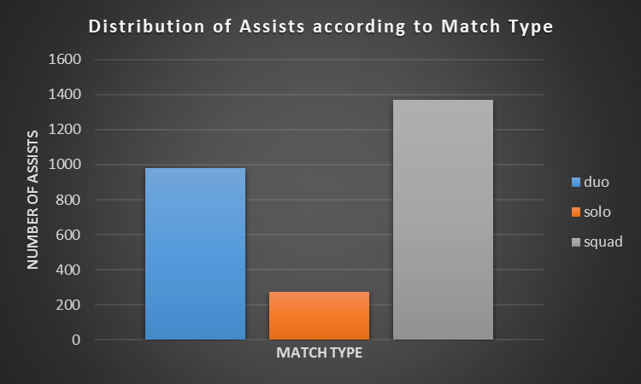
Assists Statistics – Bar Plot
The maximum number of assists is in the Squad Battle as there are 4 players in a team – 1369 assists

Slide 13
Descriptive Statistics - Summary
On average a player uses 3.7 weapons in a single game & 83% of the players acquire more than 1 weapon
If a player kills 7 enemies in a match, the player has already exceeded 99% of other players
On average a player walks 1250 meters and rides 768 meters in a squad battle which is the highest compared to Duo and Solo battles
72% of the players use less than 1 Boost item & 57% of the players didn’t use any Boost item
76% of the players use less than 1 Heal item & 62% of the players didn’t use any Heal item

Slide 14

PART B
ASSOCIATION BETWEEN VARIABLES

Slide 15
OBJECTIVES
To analyse and model the best strategy to win the game using a random sample of 15000 observations
Evaluate significant variables affecting the Win placement of a player
Identify co-relation between significant variables
Interpret and evaluate the final regression model
Forecast and predict the values
Check RMSE and MAD

Slide 16
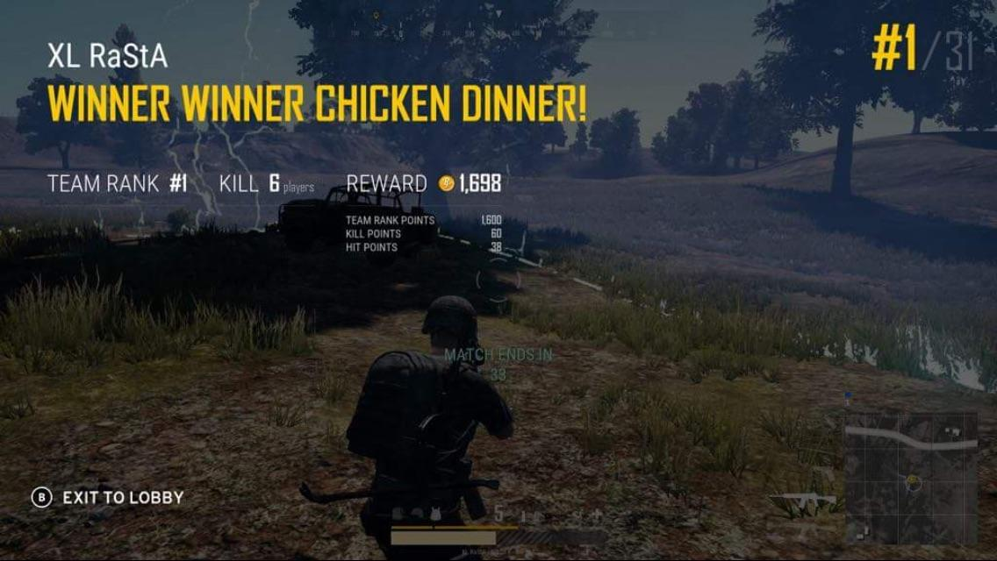
DEPENDENT VARIABLE – WIN PLACE %
The dependent variable is Win Place %
This variable takes values between 0 and 1 (e.g. 0.11, 0.88)
Converted it into percentage for better prediction (e.g. 11%, 88%)
Higher the value better the chances of winning

Slide 17
EXPLANATORY VARIABLES & OUR EXPECTATIONS
Assists – The more players one assists, the better than chances of winning
Boosts – The more boost items consumed, the better than chances of winning
DBNOs – The more players you knockout, the better than chances of winning
HeadShotKills – The more no. of HeadShotKills, the better than chances of winning
Revive – The more teammates you revive, the better than chances of winning
WalkDistance – The more you walk, the better than chances of winning
WeaponsAcquired – The more no. of weapons you acquire, the better than chances of winning
Dummy Variables – Match Type (Squad, Duo and Solo) – The chances of winning depends on match type
Interaction Variables – (Squad * Kills) – The number of enemies killed differs by match type

Slide 18
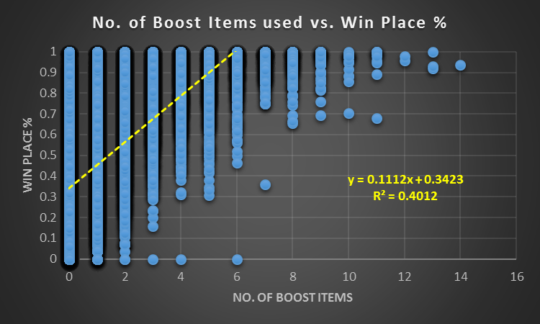
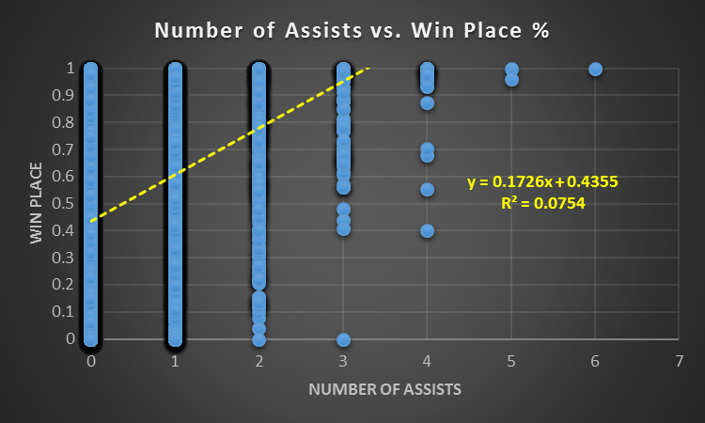
Boost Items & Assist- Significant Predictors
The Boost Items & Win Place %
R² = 0.4012
For every additional boost item used by a player, the predicted chances of winning the game increases by 11.1%
The Number of Assists & Win Place %
R² = 0.0754
For every additional assist a player provides, the predicted chances of winning the game increases by 17%

Slide 19
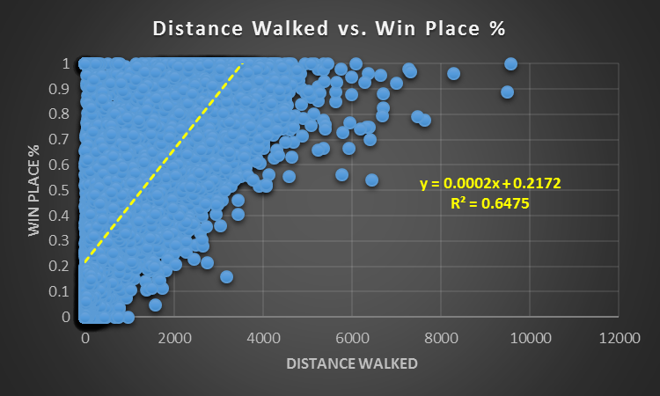
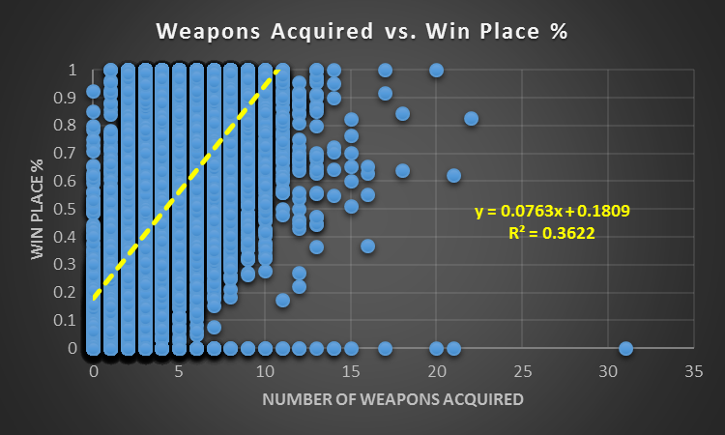
Walk Distance & Weapons Acquired - Scatterplots
The Distance Walked (meters) & Win Place %
R² = 0.6475
For every additional 1 meter walked by a player, the predicted chances of winning the game increases by 0.02%
The number of weapons acquired & Win Place %
R² = 0.3622
For every additional weapon acquired by a player, the predicted chances of winning the game increases by 7.6%

Slide 20
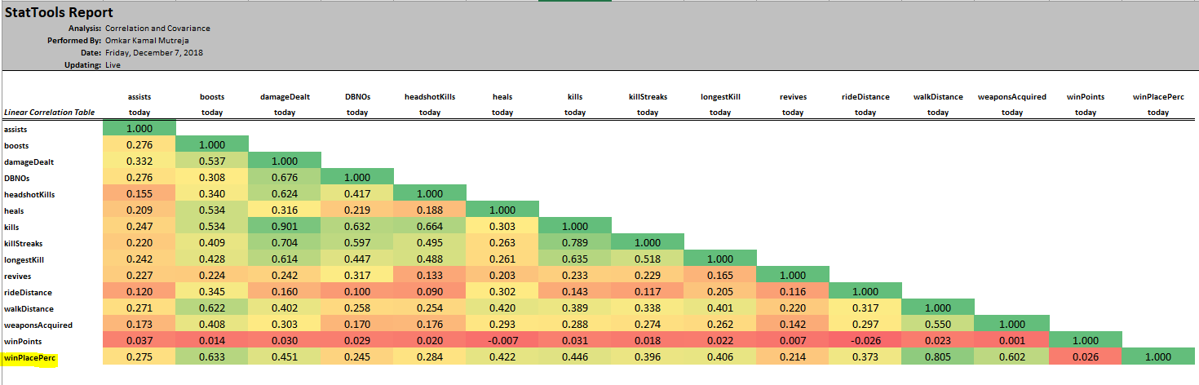
Co-relation Analysis
The variables that are highly co-related with the Win Place % on performing co-relation analysis are Boosts, DamageDealt, Heals, Kills, WalkDistance & Weapons Acquired

Slide 21
Comparative Analysis – Scatter Plots & Correlation
Predictor | Scatter Plot Analysis | Correlation Analysis
Boosts | Strong Association (+) | Highly Correlated (+)
DamageDealt | Medium Association (+) | Medium Correlated (+)
Heals | Medium Association (+) | Medium Correlated (+)
Kills | Medium Association (+) | Medium Correlated (+)
Walk Distance | Strong Association (+) | Highly Correlated (+)
Weapons Acquired | Strong Association (+) | Highly Correlated (+)
Assists | Poor Association (+) | Poorly Correlated (+)

Slide 22
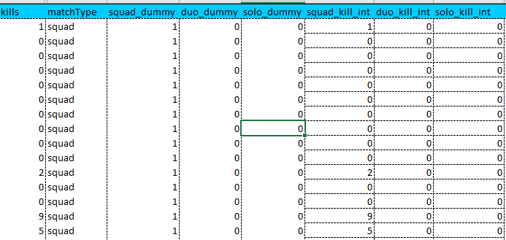
Dummy & Interaction Variables
Dummy Variable
We have created 3 Dummy variables for
Match Type – Squad, Duo & Solo
squad_dummy, duo_dummy & solo_dummy
Interaction Variable
We have created 3 Interaction variables for
Match Type Dummy variables * Kills
squad_kill_int, duo_kill_int & solo_kill_int

Slide 23
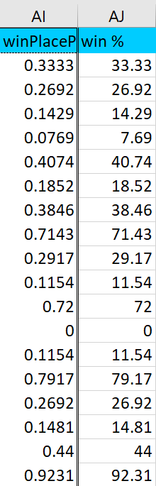
Multiple Regression to Predict Win Place %
Converting Dependent Variable WinPlacePer into a percentage value for easier interpretation
Choosing the below variables for running multiple regression and then eliminating the non-significant ones
using backward approach
Assists boosts
damageDealt DBNOs
headshotKills heals
Kills squad_dummy
duo_dummy squad_kill_int
duo_kill_int revives
rideDistance walkDistance
weaponsAcquired winPoints

Slide 24
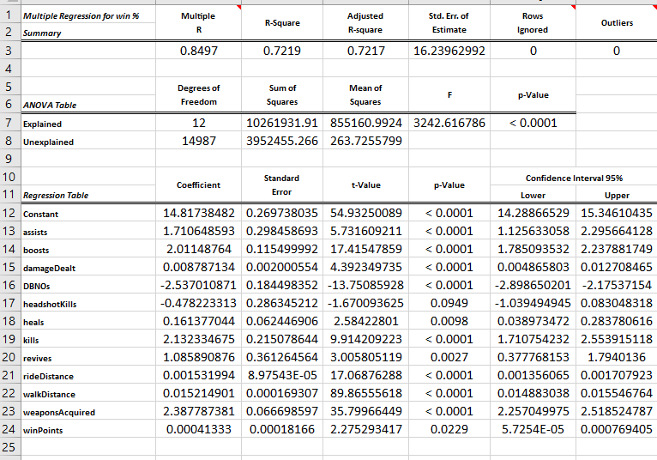
Model 1 – Numeric Variables
Choosing the below variables for running multiple regression and then eliminating the non-significant ones
using backward stepwise approach
Assists boosts
damageDealt DBNOs
headshotKills heals
Kills revives
rideDistance walkDistance
weaponsAcquired winPoints
headshotKills is not significant and hence
removing it in the next run

Slide 25
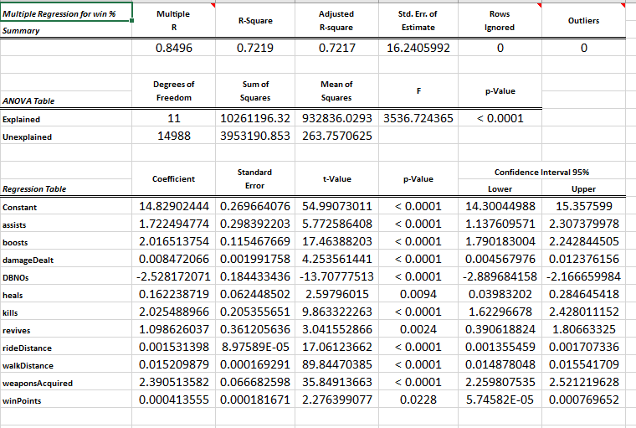
Model 1 – Numeric Variables
Final Model 1 with all significant predictors
For a alpha value of 0.95
All variables have p-value < 0.05
Assists boosts
damageDealt DBNOs
heals
Kills revives
rideDistance walkDistance
weaponsAcquired winPoints
Adjusted R-square 0.7217

Slide 26
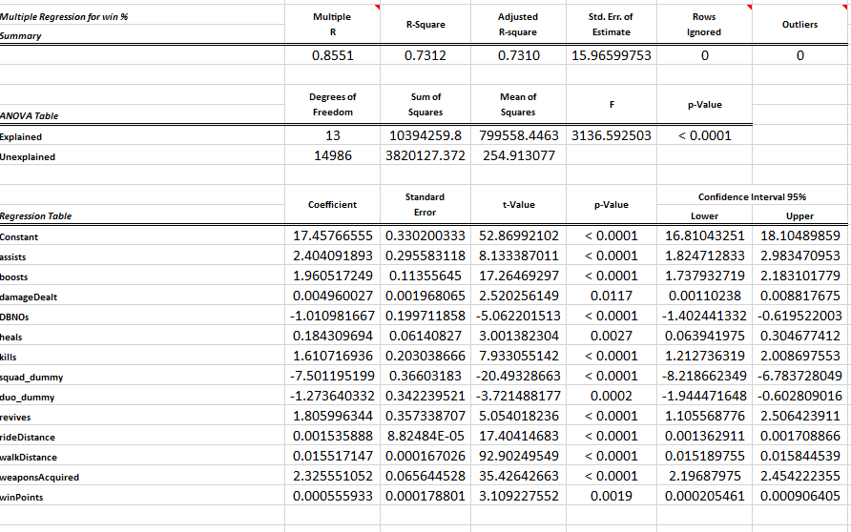
Model 2 – Numeric Variables along with Dummy
Choosing the below variables for running multiple regression along with dummy variables
Numeric:
Assists boosts damageDealt DBNOs
Heals Kills revives
rideDistance walkDistance
weaponsAcquired winPoints
Dummy:
squad_dummy, duo_dummy & solo_dummy
Adjusted R-square increases to 0.7310

Slide 27
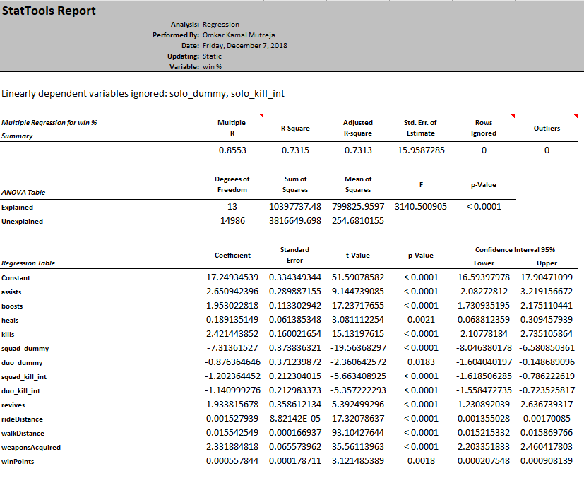
Model 3 – Numeric , Dummy and Interaction Variables
Final Model with all significant predictors
For a alpha value of 0.95
All variables have p-value < 0.05
Constant Reference: solo_dummy and solo_kill_int
WinPlace % = Constant + b0*assists + b1*boosts + b2*heals + b3*kills + b4*squad_dummy + b5*duo_dummy + b6*squad_kill_int + b7*duo_kill_int + b8*revives + b9*rideDistance + b10*walkDistance + b11*weaponsAcquired + b12*winPoints
Adjusted R-square increases to 0.7313

Slide 28
Model Comparison
Model 1 – Numeric | Model 2 – Numeric & Dummy | Model 3 – Numeric, Dummy & Interaction
Adjusted R-square – 0.7217 | Adjusted R-square – 0.7310 | Adjusted R-square – 0.7313
Model 3 is the best model in terms of Adjusted R-square
Both dummy variables and interaction have an additional effect on winPlacePer

Slide 29
Interpreting the coefficients of the predictors
Assists – Keeping all other variables constant, for one additional assist provided by the player, the predicted chances of winning the game increases by 2.65%
Kills – Keeping all other variables constant, for one additional enemy killed by the player, the predicted chances of winning the game increases by 2.42%
Squad_dummy - Keeping all other variables constant, the predicted chances of winning the game decreases by 7.31% more if the match_type is squad battle compared to solo battle
Squad_kill_int - Keeping all other variables constant, for squad battles every additional enemy killed by the player is predicted to decrease the winning percentage by 1.20% more than for solo battles

Slide 30
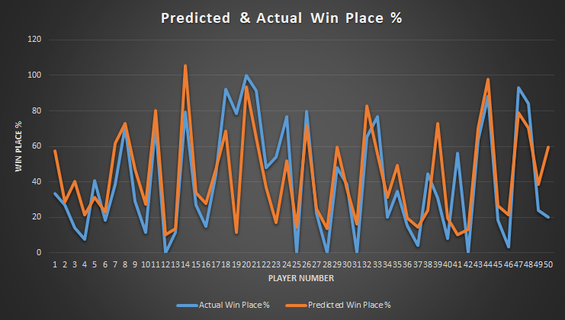
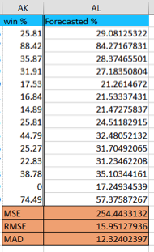
Prediction and Calculating Evaluation Metrics
MAD – 12.32
MSE – 254.44
RMSE – 15.95

Slide 31
Conclusion
Model 3 is the best model with dummy and interaction variables for predicting the WinPlacePercentage (Adjusted R square – 0.7313)
The most significant predictors are assists, kills, weapons Acquired, Walk Distance
and Match type
The final RMSE of the model is 15.95 and MAD is 12.32
Players all over the world can study this model and focus on the important elements of the game to improve their chances of winning ( Important elements – Significant Predictors)

Slide 32
